Slide 1
Unit 3
Two-Dimensional Geometric Transformations

Slide 2
Syllabus
Two-Dimensional translation, Rotation, Scaling, Reflection and Shearing
Homogeneous Coordinate and 2D Composite Transformations.
Transformation between Co-ordinate Systems
Two Dimensional Viewing: Viewing pipeline, Window to viewport coordinate transformation
Clipping: Point, Lines(Cohen-Sutherland line clipping, Liang-Barsky Line Clipping), Polygon Clipping(Sutherland Hodgeman polygon clipping)

Slide 3
Two-Dimensional Transformations
Changing co-ordinate description of an object is called transformation.
Types:
Rigid body transformation (transformation without change in shape.)
Non rigid body transformation (transformation with change in shape.)
When a transformation takes place on a 2D plane, it is called 2D transformation.
The three basic transformations are
Translation
Rotation
Scaling
Other transformation includes reflection and shear.
[Note: 2D or two-dimensional are same terms]

Slide 4
Basic Transformations
The orientation, size, and shape of the output primitives are accomplished with geometric transformations that alter the coordinate descriptions of objects.
The basic geometric transformations are translation, rotation, and scaling.
Other transformations that are often applied to objects include reflection and shear. In these all cases we consider the reference point is origin so if we have to do these transformations about any point then we have to shift these point to the origin first and then perform required operation and then again shift to that position.

Slide 5
Basic Transformations
Translation
Rotation
Scaling
Reflection
shearing

Slide 6
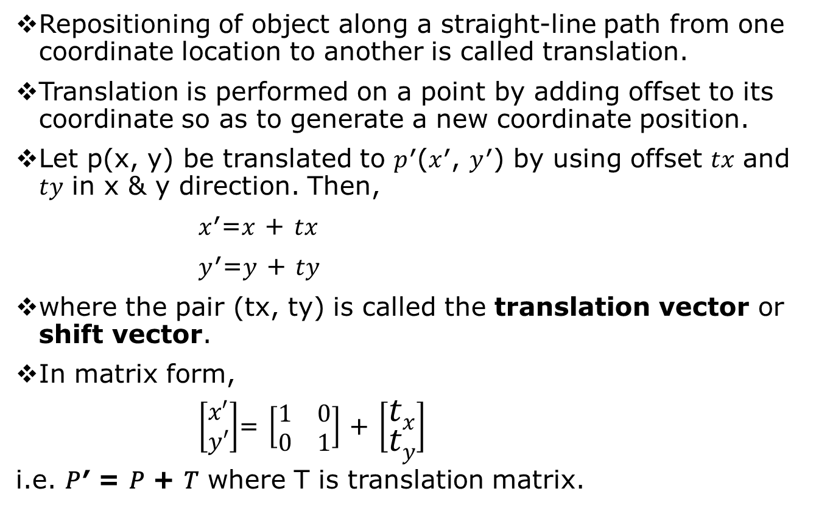
2D Translation
Repositioning of object along a straight-line path from one coordinate location to another is called translation.
Translation is performed on a point by adding offset to its coordinate so as to generate a new coordinate position.
Let p(x, y) be translated to 𝑝′(𝑥′, 𝑦′) by using offset 𝑡𝑥 and 𝑡𝑦 in x & y direction. Then,
𝑥′=𝑥 + 𝑡𝑥
𝑦′=𝑦 + 𝑡𝑦
where the pair (tx, ty) is called the translation vector or shift vector.
In matrix form,
$\left[\begin{matrix}x′ \\ y′\end{matrix}\right]$= $\left[\begin{matrix}1 & 0 \\ 0 & 1\end{matrix}\right]$ + $\left[\begin{matrix}tx \\ ty\end{matrix}\right]$
i.e. 𝑃′ = 𝑃 + 𝑇 where T is translation matrix.

Slide 7
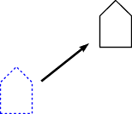
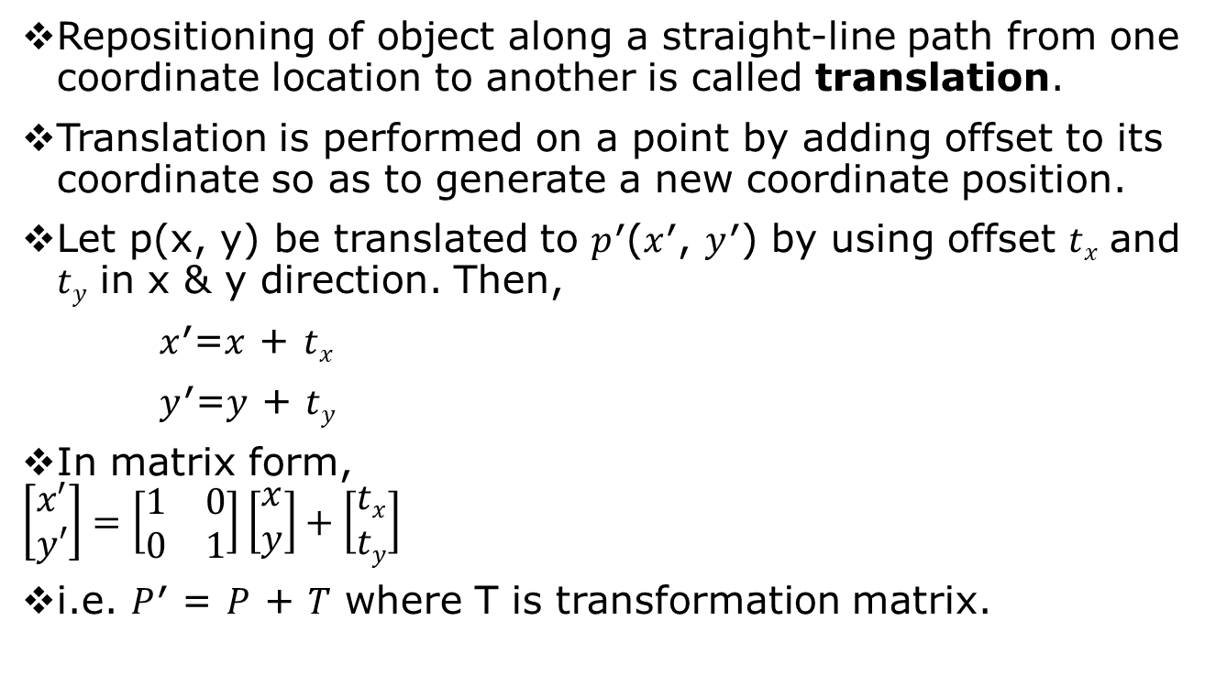
2D Translation
Repositioning of object along a straight-line path from one coordinate location to another is called translation.
Translation is performed on a point by adding offset to its coordinate so as to generate a new coordinate position.
Let p(x, y) be translated to 𝑝′(𝑥′, 𝑦′) by using offset 𝑡_{𝑥} and 𝑡_{𝑦} in x & y direction. Then,
𝑥′=𝑥 + 𝑡_{𝑥}
𝑦′=𝑦 + 𝑡_{𝑦}
In matrix form,
$$\left[\begin{matrix}x′ \\ y′\end{matrix}\right]=\left[\begin{matrix}1 & 0 \\ 0 & 1\end{matrix}\right]\left[\begin{matrix}x \\ y\end{matrix}\right]+\left[\begin{matrix}tx \\ ty\end{matrix}\right]$$
i.e. 𝑃′ = 𝑃 + 𝑇 where T is transformation matrix.

Slide 8
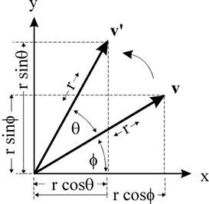

2D Rotation
Changing the co-ordinate position along a circular path is called rotation.
2D rotation is applied to re-position the object along a circular path in XY-plane. Rotation is generated by specifying rotation angle (𝜃) and pivot point (rotation point).
The positive 𝜃 rotates object in anti-clockwise direction and the negative value of 𝜃 rotates the object in clockwise direction.
Let 𝑝(𝑥, 𝑦) be a point rotated by 𝜃 about origin to new point 𝑝′(𝑥′, 𝑦′).
Here,
𝑥′ = 𝑟𝑐𝑜𝑠(∅ + 𝜃)
= 𝑟𝑐𝑜𝑠∅𝑐𝑜𝑠𝜃 − 𝑟𝑠𝑖𝑛∅𝑠𝑖𝑛𝜃
But 𝑥 = 𝑟𝑐𝑜𝑠∅ & 𝑦 = 𝑟𝑠𝑖𝑛∅
∴ 𝒙′ = 𝒙𝒄𝒐𝒔𝜽 − 𝒚𝒔𝒊𝒏𝜽 …….(i)
Similarly,
∴ 𝒚′ = 𝒙𝒔𝒊𝒏𝜽 + 𝒚𝒄𝒐𝒔𝜽 …….(ii)
Which are equation for rotation of (x, y) with angle 𝜃 and taking pivot
as origin.
y
𝑝′(𝑥′, 𝑦′)
𝑝(𝑥, 𝑦)
r
𝜃
∅

Slide 9
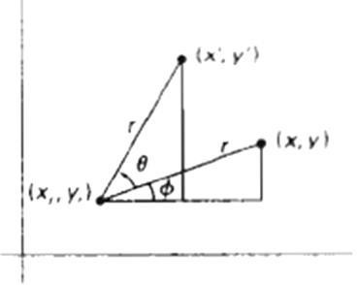
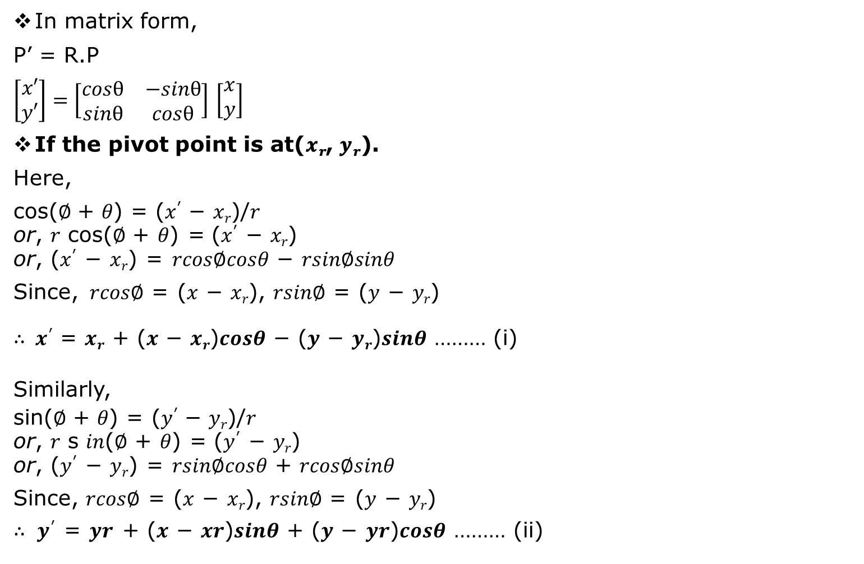
2D Rotation
In matrix form,
P’ = R.P
$\left[\begin{matrix}x′ \\ y′\end{matrix}\right]=\left[\begin{matrix}cosθ & −sinθ \\ sinθ & cosθ\end{matrix}\right]$ $\left[\begin{matrix}x \\ y\end{matrix}\right]$
If the pivot point is at(𝒙_{𝒓}, 𝒚_{𝒓}).
Here,
cos(∅ + 𝜃) = (𝑥′ − 𝑥_{𝑟})/𝑟
or, 𝑟 cos(∅ + 𝜃) = (𝑥′ − 𝑥_{𝑟})
or, (𝑥′ − 𝑥_{𝑟}) = 𝑟𝑐𝑜𝑠∅𝑐𝑜𝑠𝜃 − 𝑟𝑠𝑖𝑛∅𝑠𝑖𝑛𝜃
Since, 𝑟𝑐𝑜𝑠∅ = (𝑥 − 𝑥_{𝑟}), 𝑟𝑠𝑖𝑛∅ = (𝑦 − 𝑦_{𝑟})
∴ 𝒙′ = 𝒙_{𝒓} + (𝒙 − 𝒙_{𝒓})𝒄𝒐𝒔𝜽 − (𝒚 − 𝒚_{𝒓})𝒔𝒊𝒏𝜽 ……… (i)
Similarly,
sin(∅ + 𝜃) = (𝑦′ − 𝑦_{𝑟})/𝑟
or, 𝑟 s 𝑖𝑛(∅ + 𝜃) = (𝑦′ − 𝑦_{𝑟})
or, (𝑦′ − 𝑦_{𝑟}) = 𝑟𝑠𝑖𝑛∅𝑐𝑜𝑠𝜃 + 𝑟𝑐𝑜𝑠∅𝑠𝑖𝑛𝜃
Since, 𝑟𝑐𝑜𝑠∅ = (𝑥 − 𝑥_{𝑟}), 𝑟𝑠𝑖𝑛∅ = (𝑦 − 𝑦_{𝑟})
∴ 𝒚′ = 𝒚𝒓 + (𝒙 − 𝒙𝒓)𝒔𝒊𝒏𝜽 + (𝒚 − 𝒚𝒓)𝒄𝒐𝒔𝜽 ……… (ii)
These equations (i) and (ii) are the equations for rotation of a point (x, y) with angle 𝜃 taking pivot point(x_{r}, y_{r}).

Slide 10
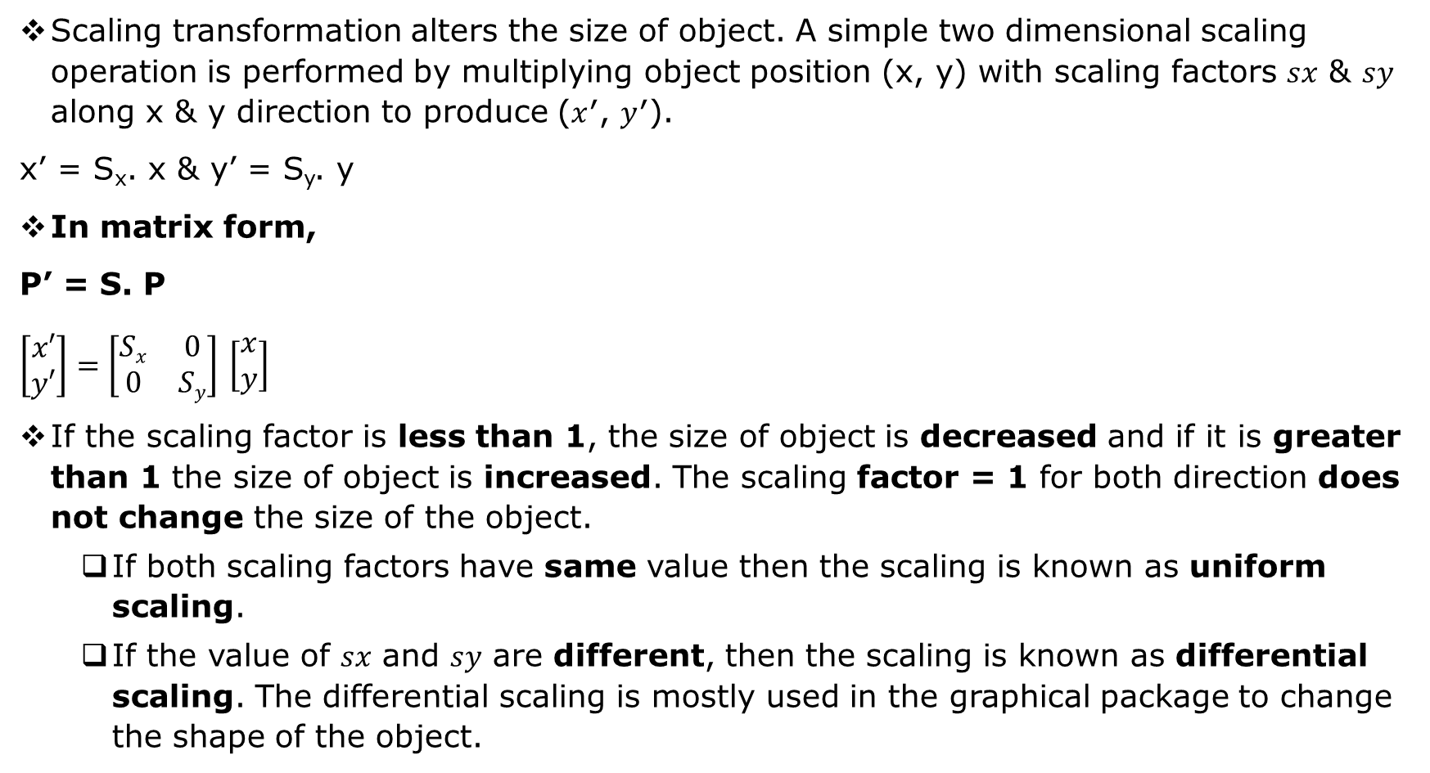
2D Scaling
Scaling transformation alters the size of object. A simple two dimensional scaling operation is performed by multiplying object position (x, y) with scaling factors 𝑠𝑥 & 𝑠𝑦 along x & y direction to produce (𝑥′, 𝑦′).
x’ = S_{x}. x & y’ = S_{y}. y
In matrix form,
P’ = S. P
$\left[\begin{matrix}x′ \\ y′\end{matrix}\right]=\left[\begin{matrix}Sx & 0 \\ 0 & Sy\end{matrix}\right]$ $\left[\begin{matrix}x \\ y\end{matrix}\right]$
If the scaling factor is less than 1, the size of object is decreased and if it is greater than 1 the size of object is increased. The scaling factor = 1 for both direction does not change the size of the object.
If both scaling factors have same value then the scaling is known as uniform scaling.
If the value of 𝑠𝑥 and 𝑠𝑦 are different, then the scaling is known as differential scaling. The differential scaling is mostly used in the graphical package to change the shape of the object.

Slide 11
2D Scaling
If fixed point is (𝑥_{𝑓}, 𝑦_{𝑓}) about which rotation is made, then
𝑥′ = 𝑥. 𝑠_{𝑥} + 𝑥_{𝑓}(1 − 𝑠_{𝑥})
𝑦′ = 𝑦. 𝑠_{𝑦} + 𝑦_{𝑓}(1 − 𝑠_{𝑦})

Slide 12
Homogeneous Coordinate Form
Expressing position in homogeneous coordinates allows us to represent all geometric transformations equation as matrix multiplications.
(x, y) -------------------- (x_{h}, y_{h} ,h)
x= x_{h} /h y= y_{h} /h
where h is any non zero value
For convenient, we take h=1
(x, y)-------------------------(x, y, 1).

Slide 13
Matrix representation & Homogenous coordinate
The homogeneous co-ordinate system provides a uniform framework for handling different geometric transformations, simply as multiplication of matrices.
To perform more than one transformation at a time, homogeneous coordinates are used. They reduce unwanted calculations, intermediate steps, saves time and memory and produce a sequence of transformations.
We represent each Cartesian coordinate position (x, y) with the homogeneous coordinate triple(𝑥_{ℎ}, 𝑦_{ℎ}, ℎ), where, 𝑥 = 𝑥_{ℎ}/ℎ, 𝑦 = 𝑦_{ℎ}/ℎ. (h is 1 usually for 2D case).
Therefore, (x, y) in Cartesian system is represented as (x, y, 1) in homogeneous co-ordinate system.

Slide 14
Need for the Homogeneous Co-ordinates
The homogeneous co-ordinate system provides a uniform framework for handling different geometric transformations, simply as multiplication of matrices.
To express any two-dimensional transformation as a matrix multiplication.
To represent all the transformation equations as matrix multiplication.
To perform more than one transformation at a time.
To reduce unwanted calculations of intermediate steps, to save time and memory and produce a sequence of transformations.

Slide 15
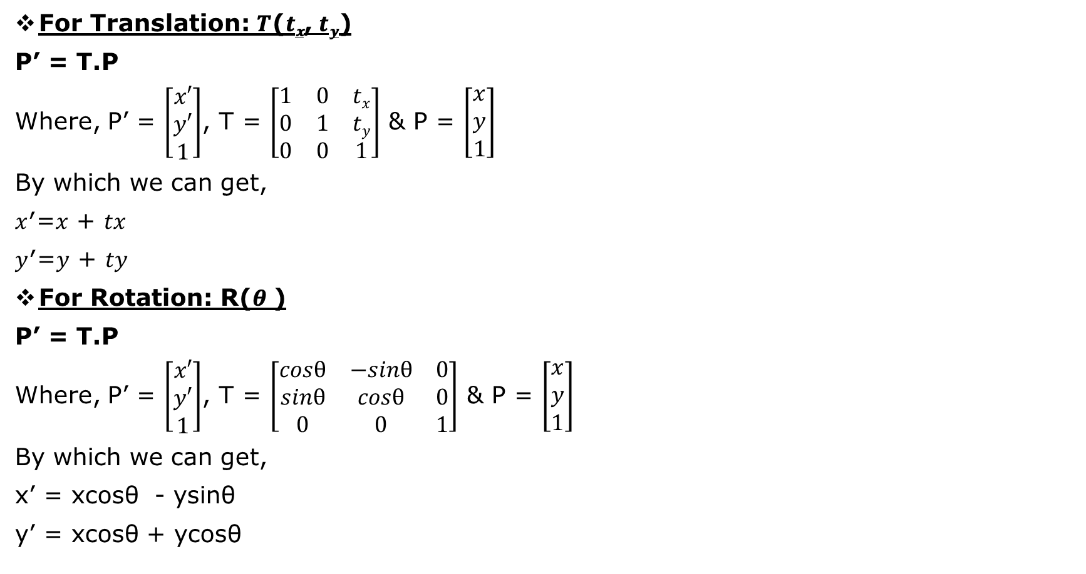
Matrix representation & Homogenous coordinate
For Translation: 𝑻(𝒕_{𝒙}, 𝒕_{𝒚})
P’ = T.P
Where, P’ = $\left[\begin{matrix}x′ \\ y′ \\ 1\end{matrix}\right]$, T = $\left[\begin{matrix}1 & 0 & tx \\ 0 & 1 & ty \\ 0 & 0 & 1\end{matrix}\right]$ & P = $\left[\begin{matrix}x \\ y \\ 1\end{matrix}\right]$
By which we can get,
𝑥′=𝑥 + 𝑡𝑥
𝑦′=𝑦 + 𝑡𝑦
For Rotation: R(𝜽 )
P’ = T.P
Where, P’ = $\left[\begin{matrix}x′ \\ y′ \\ 1\end{matrix}\right]$, T = $\left[\begin{matrix}cosθ & −sinθ & 0 \\ sinθ & cosθ & 0 \\ 0 & 0 & 1\end{matrix}\right]$ & P = $\left[\begin{matrix}x \\ y \\ 1\end{matrix}\right]$
By which we can get,
x’ = xcosθ - ysinθ
y’ = xcosθ + ycosθ

Slide 16

Matrix representation & Homogenous coordinate
For Scaling with scaling factors (𝒔𝒙, 𝒔𝒚)
P’ = S.P
Where, P’ = $\left[\begin{matrix}x′ \\ y′ \\ 1\end{matrix}\right]$, T = $\left[\begin{matrix}Sx & 0 & 0 \\ 0 & Sy & 0 \\ 0 & 0 & 1\end{matrix}\right]$ & P = $\left[\begin{matrix}x \\ y \\ 1\end{matrix}\right]$
By which we can get,
x’ = x.s_{x}
y’ = y.s_{y}

Slide 17
Composite Transformation
A number of transformations or sequence of transformations can be combined into single one called as composition. The resulting matrix is called as composite matrix. The process of combining is called as concatenation.
Suppose we want to perform rotation about an arbitrary point, then we can perform it by the sequence of three transformations
Translation
Rotation
Reverse Translation
The ordering sequence of these numbers of transformations must not be changed. If a matrix is represented in column form, then the composite transformation is performed by multiplying matrix in order from right to left side. The output obtained from the previous matrix is multiplied with the new coming matrix

Slide 18
Example showing Composite Transformations
The enlargement is with respect to center. For this following sequence of transformations will be performed and all will be combined to a single one
Step1: The object is kept at its position as in fig (a)
Step2: The object is translated so that its center coincides with the origin as in fig (b)
Step3: Scaling of an object by keeping the object at origin is done in fig (c)
Step4: Again translation is done. This second translation is called a reverse translation. It will position the object at the origin location.
Above transformation can be represented as T_{V}.S.T_{V}⁻¹.

Slide 19
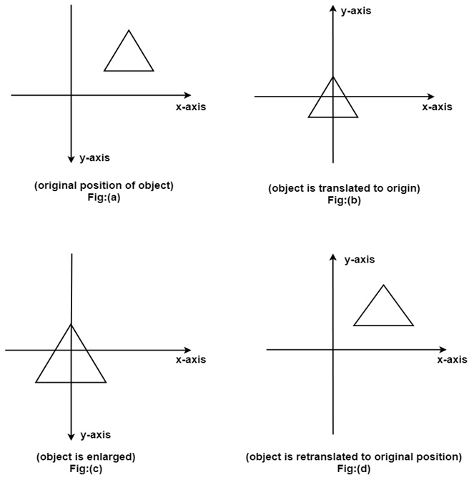
Example showing Composite Transformations

Slide 20
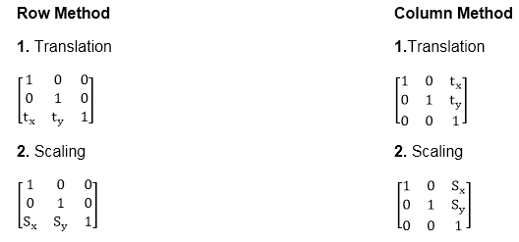
Example showing Composite Transformations
Note: Two types of rotations are used for representing matrices one is column method. Another is the row method.

Slide 21
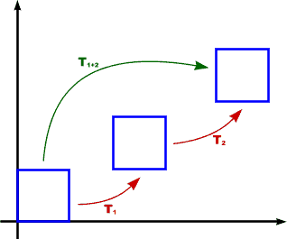
Composite Transformation
Translation
P' = T₂.T₁.P = T(tx₂, ty₂).T(tx₁, ty₁).P = T(tx₂ + tx₁, ty₂ + ty₁).P

Slide 22
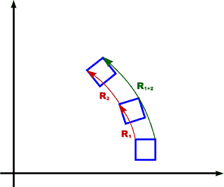
Composite Transformation
Rotation
P' = R(θ₂).R(θ₁).P
= R(θ₂ + θ₁).P

Slide 23
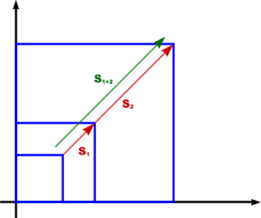
Composite Transformation
Scaling
P' = S(sx₂, sy₂).S(sx₁, sy₁).P = S(sx₂.sx₁, sy₂.sy₁).P

Slide 24
Assignments
Q1. Prove that two successive translations are additive.
Q2. Prove that two successive scaling are multiplicative.
Q3. Prove that two successive rotation are additive.

Slide 25
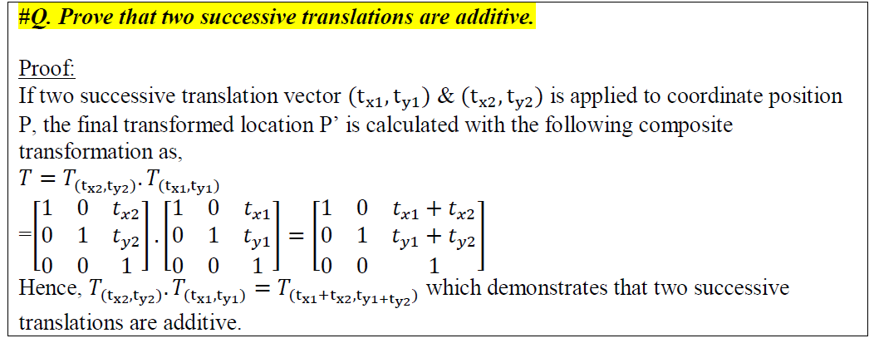
Assignment solution

Slide 26
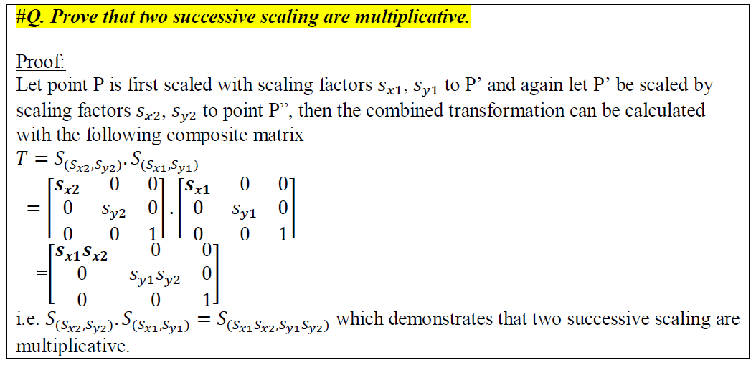
Assignment solution

Slide 27
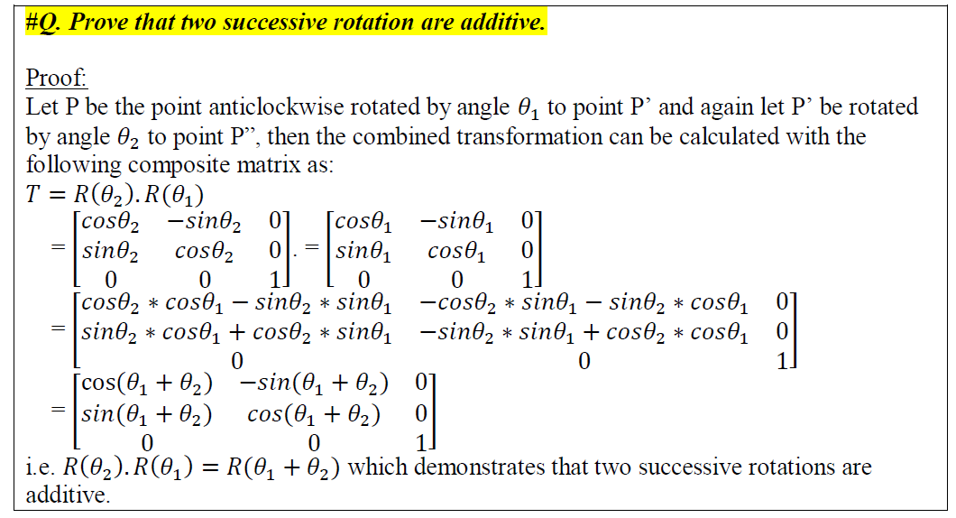
Assignment solution

Slide 28
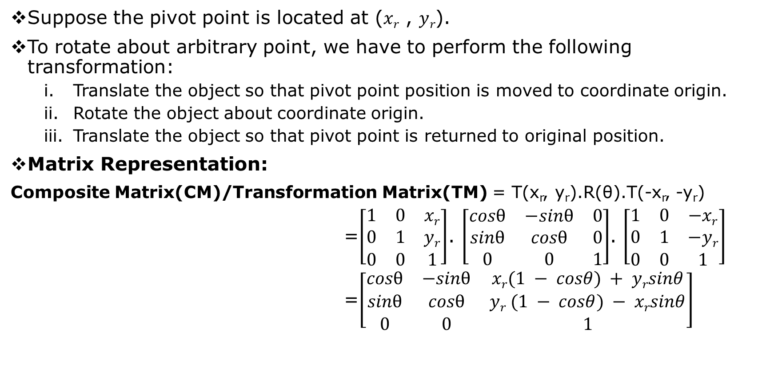
General 2D Pivot Rotation
Suppose the pivot point is located at (𝑥_{𝑟} , 𝑦_{𝑟}).
To rotate about arbitrary point, we have to perform the following transformation:
Translate the object so that pivot point position is moved to coordinate origin.
Rotate the object about coordinate origin.
Translate the object so that pivot point is returned to original position.
Matrix Representation:
Composite Matrix(CM)/Transformation Matrix(TM) = T(x_{r}, y_{r}).R(θ).T(-x_{r}, -y_{r})
=$\left[\begin{matrix}1 & 0 & xr \\ 0 & 1 & yr \\ 0 & 0 & 1\end{matrix}\right]$. $\left[\begin{matrix}cosθ & −sinθ & 0 \\ sinθ & cosθ & 0 \\ 0 & 0 & 1\end{matrix}\right]$. $\left[\begin{matrix}1 & 0 & −xr \\ 0 & 1 & −yr \\ 0 & 0 & 1\end{matrix}\right]$
=$\left[\begin{matrix}cosθ & −sinθ & xr(1 − cosθ) + yrsinθ \\ sinθ & cosθ & yr (1 − cosθ) − xrsinθ \\ 0 & 0 & 1\end{matrix}\right]$

Slide 29
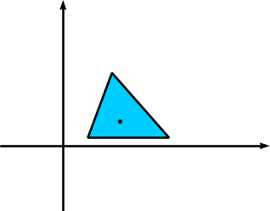
General Pivot Point Rotation
A transformation sequence for rotating an object about a specified pivot point using the rotation matrix.
Original Position of Object and Pivot Point

Slide 30
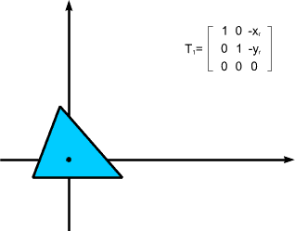
General Pivot Point Rotation
1
Translation of Object so that Pivot Point is at Origin

Slide 31
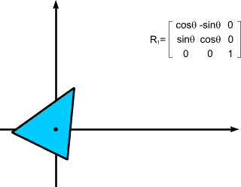
General Pivot Point Rotation
Rotation about Origin

Slide 32
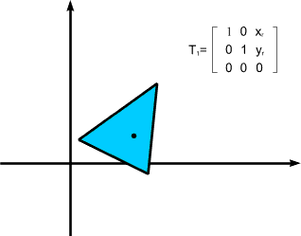
General Pivot Point Rotation
1
Translation of Object so that Pivot Point is Returned to original Position
P' = T(x_{r}, y_{r}) . R(θ) . T(-x_{r}, -y_{r}) . P = $\left[\begin{matrix}cosθ & −sinθ & xr\left(1 −cosθ\right)+yrsinθ \\ sinθ & cosθ & yr\left(1 −cosθ\right)−xrsinθ \\ 0 & 0 & 1\end{matrix}\right]$.P

Slide 33
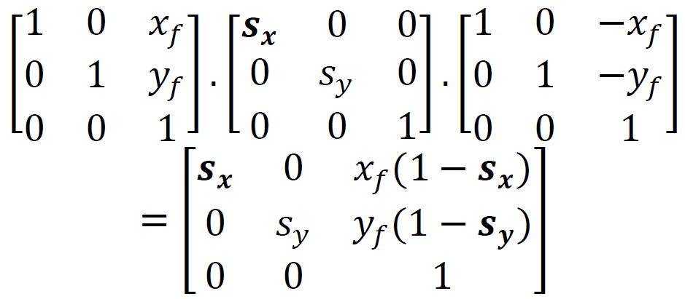
General Fixed point scaling
To represent fixed point scaling using matrix equations in homogeneous co-ordinate system, we can use composite transformation as in fixed point rotation.
Translate object to the origin so that (x_{f}, y_{f}) lies at origin by T(-x_{f}, -y_{f}).
Scale the object with (s_{x}, s_{y})
Re-translate the object back to its original position so that fixed point (x_{f}, y_{f}) moves to its original position. In this case translation vector is T(x_{f}, y_{f}).
Matrix Representation:

Slide 34

General Fixed Point Scaling
A transformation sequence for scaling an object with respect to a specified fixed position using the scaling matrix.
Original Position of Object and Fixed Point

Slide 35

General Fixed Point Scaling
1
Translation of Object so that Fixed Point is at Origin

Slide 36
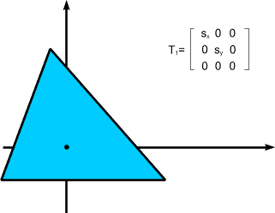
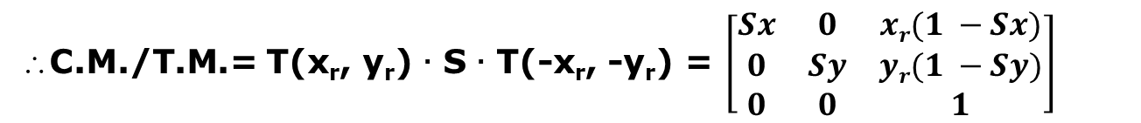
General Fixed Point Scaling
1
Scale Object with Respect to Origin
∴C.M./T.M.= T(x_{r}, y_{r}) . S . T(-x_{r}, -y_{r}) = $\left[\begin{matrix}Sx & 0 & xr(1 −Sx) \\ 0 & Sy & yr(1 −Sy) \\ 0 & 0 & 1\end{matrix}\right]$

Slide 37
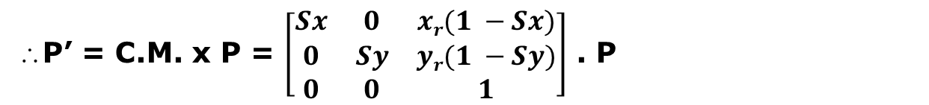
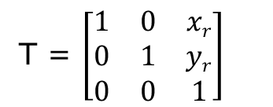
General Fixed Point Scaling
T = $\left[\begin{matrix}1 & 0 & xr \\ 0 & 1 & yr \\ 0 & 0 & 1\end{matrix}\right]$
Translation of Object so that Fixed Point is Returned to original Position
∴P’ = C.M. x P = $\left[\begin{matrix}Sx & 0 & xr(1 −Sx) \\ 0 & Sy & yr(1 −Sy) \\ 0 & 0 & 1\end{matrix}\right]$ . P

Slide 38
2D Reflection
Providing a mirror image about an axis of an object is called reflection.
It is a transformation which produces a mirror image of an object. The mirror image can be either about x-axis or y-axis. The object is rotated by 180°.

Slide 39
Types of 2D Reflection
Reflection about the x-axis
Reflection about the y-axis
Reflection about an axis perpendicular to xy plane and passing through the origin
Reflection about line y=x
Reflection about line y=-x
Reflection about line y=mx + c

Slide 40
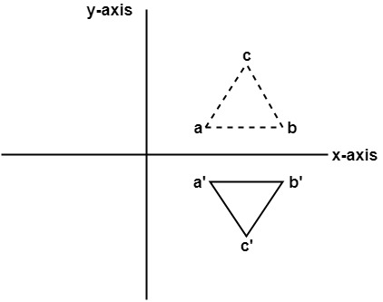
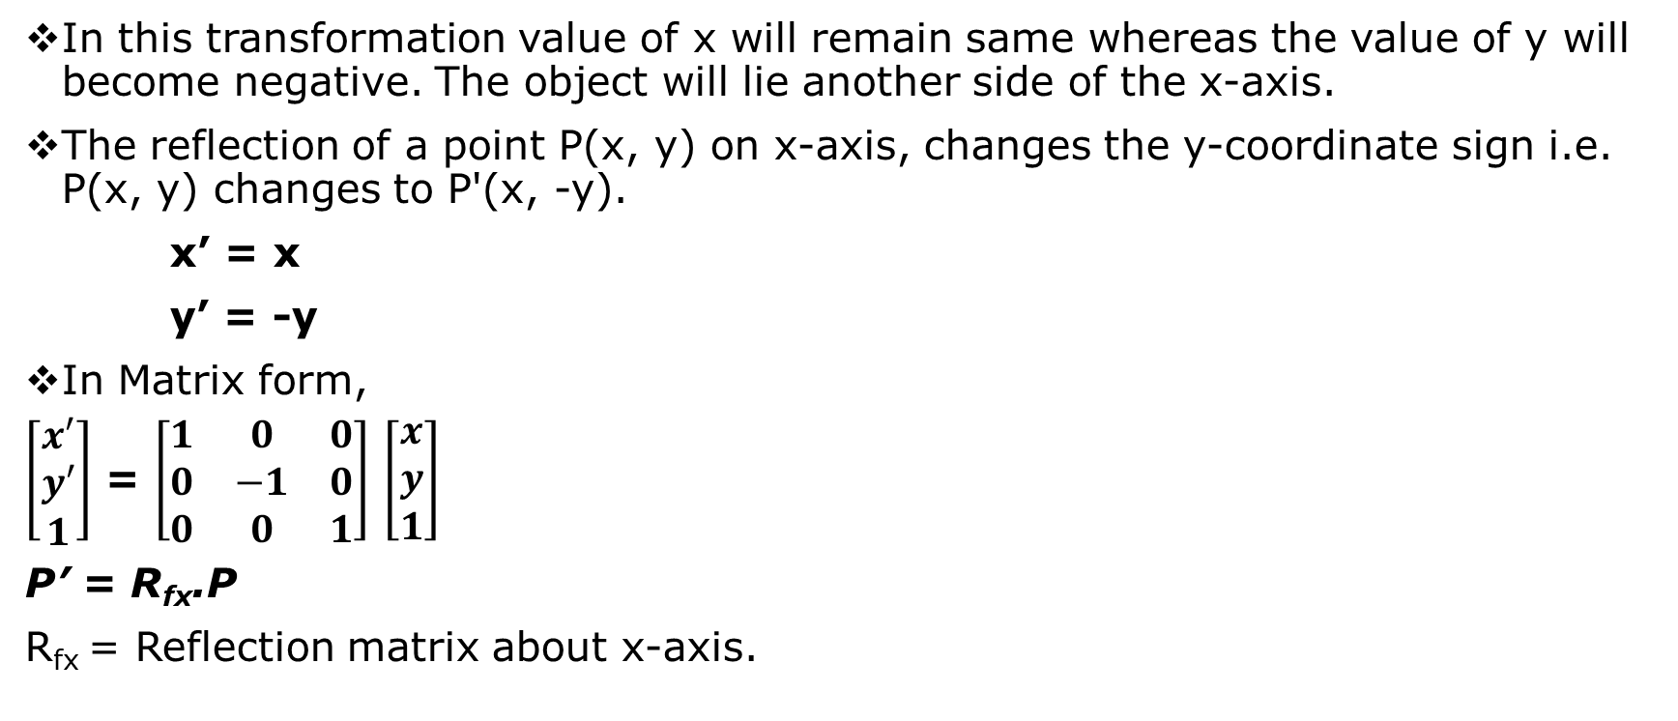
Reflection about the x-axis(y=0)
In this transformation value of x will remain same whereas the value of y will become negative. The object will lie another side of the x-axis.
The reflection of a point P(x, y) on x-axis, changes the y-coordinate sign i.e. P(x, y) changes to P'(x, -y).
x’ = x
y’ = -y
In Matrix form,
$\left[\begin{matrix}x′ \\ y′ \\ 1\end{matrix}\right]$ = $\left[\begin{matrix}1 & 0 & 0 \\ 0 & −1 & 0 \\ 0 & 0 & 1\end{matrix}\right]$ $\left[\begin{matrix}x \\ y \\ 1\end{matrix}\right]$
P’ = R_{fx}.P
R_{fx} = Reflection matrix about x-axis.

Slide 41
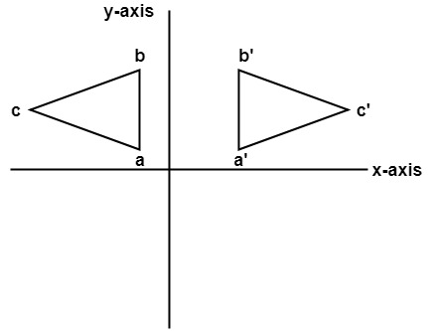
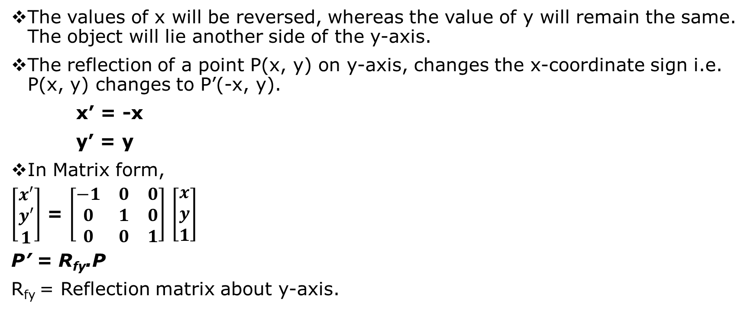
Reflection about the y-axis(x=0)
The values of x will be reversed, whereas the value of y will remain the same. The object will lie another side of the y-axis.
The reflection of a point P(x, y) on y-axis, changes the x-coordinate sign i.e. P(x, y) changes to P’(-x, y).
x’ = -x
y’ = y
In Matrix form,
$\left[\begin{matrix}x′ \\ y′ \\ 1\end{matrix}\right]$ = $\left[\begin{matrix}−1 & 0 & 0 \\ 0 & 1 & 0 \\ 0 & 0 & 1\end{matrix}\right]$ $\left[\begin{matrix}x \\ y \\ 1\end{matrix}\right]$
P’ = R_{fy}.P
R_{fy} = Reflection matrix about y-axis.

Slide 42
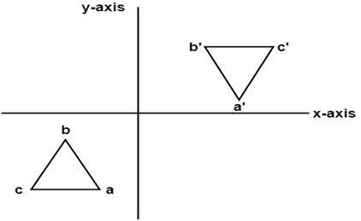

Reflection about an axis perpendicular to xy plane and passing through the origin (Reflection about origin)
In this value of x and y both will be reversed. This is also called as half revolution about the origin.
The reflection of a point P(x, y) about origin, changes the x and y-coordinate sign i.e. P(x, y) changes to P’(-x, -y).
x’ = -x
y’ = -y
In Matrix form,
$\left[\begin{matrix}x′ \\ y′ \\ 1\end{matrix}\right]$ = $\left[\begin{matrix}−1 & 0 & 0 \\ 0 & −1 & 0 \\ 0 & 0 & 1\end{matrix}\right]$ $\left[\begin{matrix}x \\ y \\ 1\end{matrix}\right]$

Slide 43
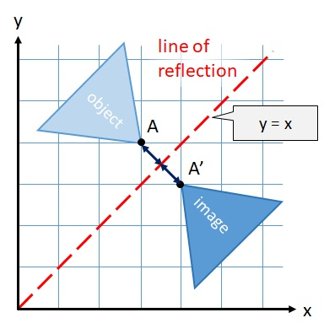

Reflection about line y = x
Cartesian Equations are;
x’ = y
y’ = x
In Homogeneous Matrix form,
$\left[\begin{matrix}x′ \\ y′ \\ 1\end{matrix}\right]$ = $\left[\begin{matrix}0 & 1 & 0 \\ 1 & 0 & 0 \\ 0 & 0 & 1\end{matrix}\right]$ $\left[\begin{matrix}x \\ y \\ 1\end{matrix}\right]$
y = x line
45°

Slide 44
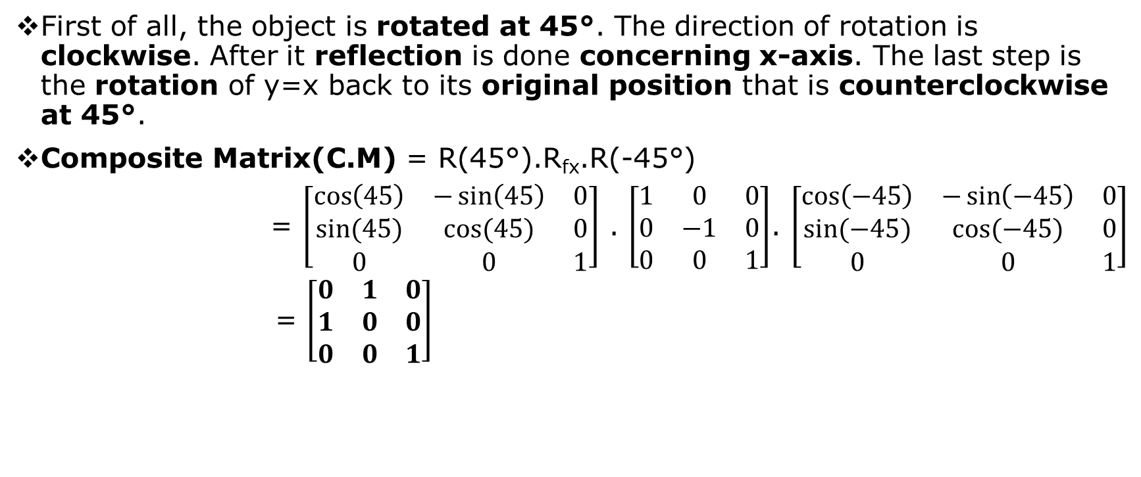
Reflection about line y=x
First of all, the object is rotated at 45°. The direction of rotation is clockwise. After it reflection is done concerning x-axis. The last step is the rotation of y=x back to its original position that is counterclockwise at 45°.
Composite Matrix(C.M) = R(45°).R_{fx}.R(-45°)
= $\left[\begin{matrix}\cos\left(45\right) & −\sin\left(45\right) & 0 \\ sin⁡(45) & cos⁡(45) & 0 \\ 0 & 0 & 1\end{matrix}\right]$ . $\left[\begin{matrix}1 & 0 & 0 \\ 0 & −1 & 0 \\ 0 & 0 & 1\end{matrix}\right]$. $\left[\begin{matrix}\cos\left(−45\right) & −\sin\left(−45\right) & 0 \\ sin⁡(−45) & cos⁡(−45) & 0 \\ 0 & 0 & 1\end{matrix}\right]$
= $\left[\begin{matrix}0 & 1 & 0 \\ 1 & 0 & 0 \\ 0 & 0 & 1\end{matrix}\right]$

Slide 45
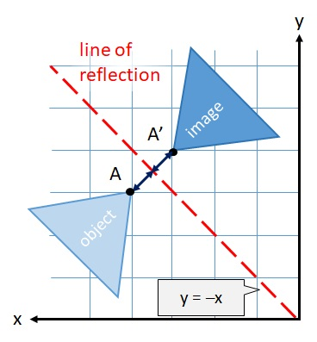

Reflection about line y = -x
Cartesian Equations are;
x’ = -y
y’ = -x
In Homogeneous Matrix form,
$\left[\begin{matrix}x′ \\ y′ \\ 1\end{matrix}\right]$ = $\left[\begin{matrix}0 & −1 & 0 \\ −1 & 0 & 0 \\ 0 & 0 & 1\end{matrix}\right]$ $\left[\begin{matrix}x \\ y \\ 1\end{matrix}\right]$
C.M. = R(-45°). R_{fx}. R(45°)
=$\left[\begin{matrix}\cos\left(−45\right) & −\sin\left(−45\right) & 0 \\ sin⁡(−45) & cos⁡(−45) & 0 \\ 0 & 0 & 1\end{matrix}\right]$. $\left[\begin{matrix}1 & 0 & 0 \\ 0 & −1 & 0 \\ 0 & 0 & 1\end{matrix}\right]$.$\left[\begin{matrix}\cos\left(45\right) & −\sin\left(45\right) & 0 \\ sin⁡(45) & cos⁡(45) & 0 \\ 0 & 0 & 1\end{matrix}\right]$
= $\left[\begin{matrix}0 & −1 & 0 \\ −1 & 0 & 0 \\ 0 & 0 & 1\end{matrix}\right]$

Slide 46

Reflection about line y = -x
Y-axis
Cartesian Equations are;
x’ = -y
y’ = -x
In Homogeneous Matrix form,
$\left[\begin{matrix}x′ \\ y′ \\ 1\end{matrix}\right]$ = $\left[\begin{matrix}0 & −1 & 0 \\ −1 & 0 & 0 \\ 0 & 0 & 1\end{matrix}\right]$ $\left[\begin{matrix}x \\ y \\ 1\end{matrix}\right]$
C.M. = R(-45°). R_{fx}. R(45°)
=$\left[\begin{matrix}\cos\left(−45\right) & −\sin\left(−45\right) & 0 \\ sin⁡(−45) & cos⁡(−45) & 0 \\ 0 & 0 & 1\end{matrix}\right]$. $\left[\begin{matrix}1 & 0 & 0 \\ 0 & −1 & 0 \\ 0 & 0 & 1\end{matrix}\right]$.$\left[\begin{matrix}\cos\left(45\right) & −\sin\left(45\right) & 0 \\ sin⁡(45) & cos⁡(45) & 0 \\ 0 & 0 & 1\end{matrix}\right]$
= $\left[\begin{matrix}0 & −1 & 0 \\ −1 & 0 & 0 \\ 0 & 0 & 1\end{matrix}\right]$
y = -x line
45°
c
X-axis
a
a’
Object
b
b’
c’
Image

Slide 47

Reflection about x = a Line
Cartesian Equations;
x’ = 2a –x
y’ = y
In homogeneous matrix form
$\left[\begin{matrix}x′ \\ y′ \\ 1\end{matrix}\right]$ = $\left[\begin{matrix}−1 & 0 & 2a \\ 0 & 1 & 0 \\ 0 & 0 & 1\end{matrix}\right]$ $\left[\begin{matrix}x \\ y \\ 1\end{matrix}\right]$

Slide 48
Reflection about x = a Line
To reflect about x = a line, we have to perform the following transformations:
Translate the line x=a to the y-axis i.e., x=0 line along with the object.
Reflect the object about the y-axis.
Restore the line to its original position with the inverse translation
X=a
X=a
y-axis
y-axis
Object
Object
x-axis
x-axis
Original Object
Translate x=a to x=0 line i.e., y-axis

Slide 49
Reflection about x = a Line
X=a
X=a
y-axis
y-axis
Object
Image
Object
Image
Reflect Object about the y-axis
x-axis
x-axis
Inverse translate the line to its original position
C.M = T_{(a, 0)}. R_{fy}. T_{(-a, 0)} = $\left[\begin{matrix}1 & 0 & a \\ 0 & 1 & 0 \\ 0 & 0 & 1\end{matrix}\right]$. $\left[\begin{matrix}−1 & 0 & 0 \\ 0 & 1 & 0 \\ 0 & 0 & 1\end{matrix}\right]$. $\left[\begin{matrix}1 & 0 & −a \\ 0 & 1 & 0 \\ 0 & 0 & 1\end{matrix}\right]$ = $\left[\begin{matrix}−1 & 0 & 2a \\ 0 & 1 & 0 \\ 0 & 0 & 1\end{matrix}\right]$

Slide 50

Reflection about y = b Line
Cartesian Equations;
x’ = x
y’ = 2b - y
In homogeneous matrix form
$\left[\begin{matrix}x′ \\ y′ \\ 1\end{matrix}\right]$ = $\left[\begin{matrix}1 & 0 & 0 \\ 0 & −1 & 2b \\ 0 & 0 & 1\end{matrix}\right]$ $\left[\begin{matrix}x \\ y \\ 1\end{matrix}\right]$

Slide 51
Reflection about y = b Line
To reflect about y = b line, we have to perform the following transformations:
Translate the line y=b to the x-axis i.e., y=0 line along with the object.
Reflect the object about the x-axis.
Restore the line to its original position with the inverse translation.
y-axis
Object
y-axis
y=b
Object
y=b
x-axis
x-axis
Original Object
Translate y=b to y=0 line i.e., x-axis

Slide 52
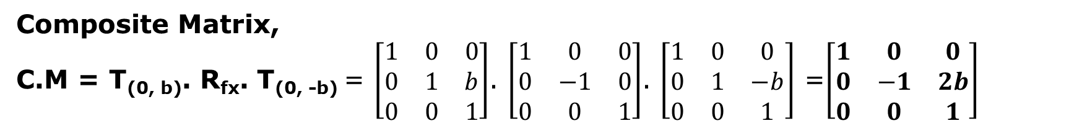
Reflection about y = b Line
y-axis
y-axis
Object
y=b
Image
Object
y=b
x-axis
Image
x-axis
Inverse translate the line to its original position
Reflect Object about the x-axis
Composite Matrix,
C.M = T_{(0, b)}. R_{fx}. T_{(0, -b)} = $\left[\begin{matrix}1 & 0 & 0 \\ 0 & 1 & b \\ 0 & 0 & 1\end{matrix}\right]$. $\left[\begin{matrix}1 & 0 & 0 \\ 0 & −1 & 0 \\ 0 & 0 & 1\end{matrix}\right]$. $\left[\begin{matrix}1 & 0 & 0 \\ 0 & 1 & −b \\ 0 & 0 & 1\end{matrix}\right]$ =$\left[\begin{matrix}1 & 0 & 0 \\ 0 & −1 & 2b \\ 0 & 0 & 1\end{matrix}\right]$

Slide 53
Reflection about line y = mx + c
Perform the following transformation:
Translate the line so that it passes through origin.
Rotate the line so that it coincides with any coordinate axis.
Reflect object about that axis.
Perform reverse rotation.
Perform reverse translation so that line is placed to its original position.

Slide 54
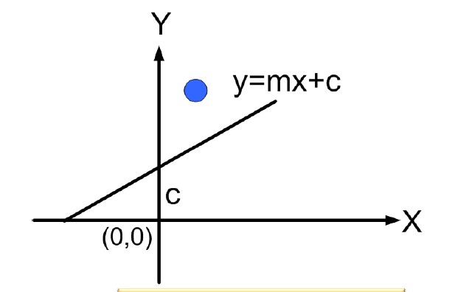
Reflection about Line y=mx+c

Slide 55
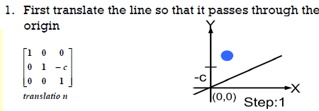
Reflection about Line y=mx+c

Slide 56
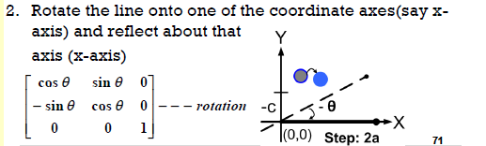
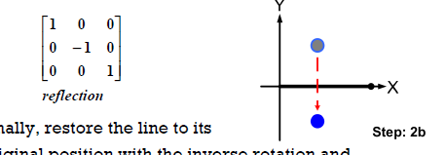
Reflection about Line y=mx+c

Slide 57
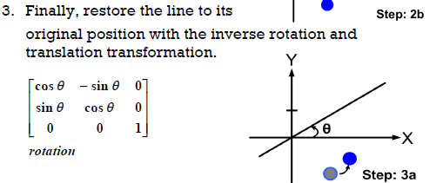
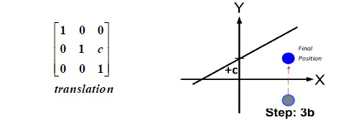
Reflection about Line y=mx+c

Slide 58
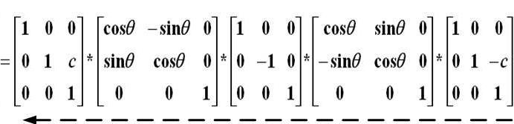
Reflection about Line y=mx+c
CM=T’_{(0,C)}. R’_{θ}. Rf_{x}. R_{(-θ)}. T_{(0,-C)}

Slide 59
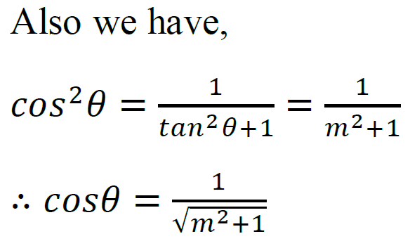

Reflection about line y = mx + c
Q. Derive the composite matrix for reflecting an object about any arbitrary line y=mx+c.
Solution:
In order to reflect an object about any line y=mx + c, we need to perform Composite transformation as below
𝑇 = 𝑇_{(0,𝑐)}. 𝑅_{(𝜃)}. 𝑅_{𝑓𝑥}. 𝑅_{(−𝜃)}. 𝑇_{(0,−𝑐)}
And
Slope m = 𝑡𝑎𝑛𝜃
y-axis
(0, c)
𝜃
x-axis

Slide 60

Reflection about line y = mx + c
Q. Derive the composite matrix for reflecting an object about any arbitrary line y=mx+c.
Solution:

Slide 61

Reflection about line y = mx + c
Q. Derive the composite matrix for reflecting an object about any arbitrary line y=mx+c.
Solution:

Slide 62

Numerical
Q. A triangle having vertices A(2, 3), B(6, 3) & C(4,8) is reflected about y=3x+4. Find the final position of triangle.
Solution:
Here,
y=3x+4
m=3, c=4
(𝑡_{𝑥} , 𝑡_{𝑦}) = (0, 𝑐) = (0, 4)
𝜃 = 𝑡𝑎𝑛⁻¹(𝑚) = 𝑡𝑎𝑛⁻¹(3) = 71.56
y=3x+4
(0, 4)
θ

Slide 63

Numerical
Q. A triangle having vertices A(2, 3), B(6, 3) & C(4,8) is reflected about y=3x+4. Find the final position of triangle.
Solution:

Slide 64


Numerical
Q. A triangle having vertices A(2, 3), B(6, 3) & C(4,8) is reflected about y=3x+4. Find the final position of triangle.
Solution:

Slide 65


Numerical
Q. A mirror is placed such that it passes through (0,10),(10, 0). Find the mirror image of an object (6,7), (7, 6), (6, 9).
Solution:
Here,
The given mirror or line is passing through
the points (0, 10) & (10, 0).
Now, the slope of the line
m = $\frac{\text{(}\text{y}\text{2}\text{−}\text{y}\text{1}\text{)}}{\text{(}\text{x}\text{2}\text{−}\text{x}\text{1}\text{)}}$ = $\frac{\text{(0 − 10)}}{\text{(10 − 0)}}$ = -1
Thus, the rotation angle (θ)= tan⁻¹(m)
= tan⁻¹(-1)
= -45°

Slide 66

Numerical
Solution:
The composite matrix is given by:
C.M.= T_{(0, 10) or (10, 0)}. R_{θ in CW} .R_{fx} .R_{θ in CCW} .T_{(0, -10) or (-10, 0)}

Slide 67


Numerical
Q. A mirror is placed such that it passes through (0,10),(10, 0). Find the mirror image of an object (6,7), (7, 6), (6, 9).
Solution:
Now, the required co-ordinate can be calculated as:
P’ = C.M * P
Hence, the final coordinates are (3, 4),
(4, 3) & (1, 4).

Slide 68




2D Shearing
A transformation that distorts the shape of an object such that the transformed shape appears as if the object is composed of internal layers and these layers are caused to slide over is shearing.
It is transformation which changes the shape of object. The sliding of layers of object occur.
The shear can be in one direction or in two directions.

Slide 69
Types of Shearing
X-direction Shear(Shearing in the X-direction)
Y-direction Shear(Shearing in the Y-direction)
X-Y directions Shearing(Shearing in the X-Y direction)
X-direction shear relative to 𝒚 = 𝒚_{𝒓𝒆𝒇}
Y-direction shear relative to 𝒙 = 𝒙_{𝒓𝒆𝒇}

Slide 70


X-direction Shear
Slides object in X-axis in right(+) or left(-).
An X-direction shear relative to x-axis with shearing factor sh_{x} is produced with transformation matrix equation.
x’ = x + sh_{x} . Y
y’ = y
In this horizontal shearing sliding of layers occur.
The homogeneous matrix for shearing in the x-direction is shown below
$\left[\begin{matrix}x′ \\ y′ \\ 1\end{matrix}\right]$ = $\left[\begin{matrix}1 & shx & 0 \\ 0 & 1 & 0 \\ 0 & 0 & 1\end{matrix}\right]$ $\left[\begin{matrix}x \\ y \\ 1\end{matrix}\right]$

Slide 71


Y-direction Shear
Slide object in Y-axis up(+) or down(-).
A Y-direction shear relative to y-axis with shearing factor sh_{y} is produced by following transformation equations.
x’ = x
y’ = sh_{y} . x + y
It preserves the x coordinates but changes the y values.
Here shearing is done by sliding along vertical or y-axis. The homogeneous matrix for shearing in the y-direction is shown below
$\left[\begin{matrix}x′ \\ y′ \\ 1\end{matrix}\right]$ = $\left[\begin{matrix}1 & 0 & 0 \\ shy & 1 & 0 \\ 0 & 0 & 1\end{matrix}\right]$ $\left[\begin{matrix}x \\ y \\ 1\end{matrix}\right]$

Slide 72

X-Y direction Shear
In x-y shear, both the x and y co-ordinates changes. If P(x, y) is the point then the new points will be P’(x’, y’) given as
x’ = x + sh_{x} . y
y’ = sh_{y} . x + y
Here layers will be slided in both x as well as y direction. The sliding will be in horizontal as well as vertical direction. The shape of the object will be distorted. The matrix of shear in both directions is given by:
$\left[\begin{matrix}x′ \\ y′ \\ 1\end{matrix}\right]$ = $\left[\begin{matrix}1 & shx & 0 \\ shy & 1 & 0 \\ 0 & 0 & 1\end{matrix}\right]$ $\left[\begin{matrix}x \\ y \\ 1\end{matrix}\right]$

Slide 73

X-direction shear relative to 𝒚 = 𝒚_{𝒓𝒆𝒇}
𝑥′ = 𝑥 + 𝑠ℎ_{𝑥} (𝑦 − 𝑦_{𝑟𝑒𝑓})
𝑦′ = 𝑦
In homogeneous matrix form;
$\left[\begin{matrix}x′ \\ y′ \\ 1\end{matrix}\right]$ = $\left[\begin{matrix}1 & shx & −shx. yref \\ 0 & 1 & 0 \\ 0 & 0 & 1\end{matrix}\right]$ $\left[\begin{matrix}x \\ y \\ 1\end{matrix}\right]$

Slide 74

Y-direction shear relative to 𝒙 = 𝒙_{𝒓𝒆𝒇}
𝑥′ = 𝑥
𝑦′ = 𝑦 + 𝑠ℎ_{𝑦}(𝑥 − 𝑥_{𝑟𝑒𝑓})
In homogeneous matrix form;
$\left[\begin{matrix}x′ \\ y′ \\ 1\end{matrix}\right]$ = $\left[\begin{matrix}1 & 0 & 0 \\ shy & 1 & −shy.xref \\ 0 & 0 & 1\end{matrix}\right]$ $\left[\begin{matrix}x \\ y \\ 1\end{matrix}\right]$

Slide 75

Matrix Representation of 2D Transformation

Slide 76

Two-Dimensional Transformation in Homogeneous Coordinate

Slide 77
Assignment 3: Numerical Problems
Q1. Find the scaled triangle with vertices A(0, 0), B(1, 1) & C(5, 2) after it has been magnified twice its size.
Q2. Rotate a triangle A(0, 0), B(2, 2), C(4, 2) about the origin by the angle of 45 degree.
Q3. Rotate a triangle (5, 5), (7, 3), (3, 3) about fixed point (5, 4) in counter clockwise by 90 degree.
Q4. Rotate a triangle A(7, 15), B(5, 8) & C(10, 10) by 45 degree clockwise about origin and scale it by (2, 3) about origin.
Q5. A square with vertices A(0, 0), B(2, 0), C(2, 2) & D(0, 2) is scaled 2 units in x & y direction about the fixed point (1, 1). Find the coordinates of the vertices of new square.
Q6. A triangle having vertices A(3, 3), B(8, 5) & C(5, 8) is first translated by 2 units, scaled with (5, 6) & finally rotated 90 degree anticlockwise about pivot point (2, 5). Find the final position of triangle.
Q7. Rotate the △ABC by 90° anti-clock wise about (5, 8) and scale it by (2, 2) about (10, 10).

Slide 78
Assignment 3: Numerical Problems
Q8. A triangle having vertices A(2, 3), B(6, 3) & C(4,8) is reflected about y=3x+4. Find the final position of triangle.
Q9. Derive the composite matrix for reflecting an object about any arbitrary line y=mx + c.
Q10. Reflect a line segment having end points (9, 3) and (12, 10) about a line y=7. Draw initial and final graph as well.

Slide 79

Two Dimensional Viewing
Two dimensional viewing is the mechanism for displaying views of a picture on an output device.
In computer graphics several coordinate systems (reference frame) are used to construct, and display a 2D scene or image.

Slide 80
2D Coordinate Systems
Modeling Coordinate system:
It is used to define coordinates that are used to construct the shape of individual parts (objects) of a 2D scene.
World Coordinate System:
Used to organize the individual objects (points, lines, circles etc) into a scene.
A scene is made up of collection of objects.
These objects make up the “scene” or “world” that we want to view, and the coordinates that we used to define the scene are called world coordinates.
Viewing Coordinate System:
Used to define a particular view of a scene. Translation, scaling, and rotation of the window will generate a different view of the scene. For a 2D picture, a view is selected by specifying by a subarea of the total picture area.

Slide 81
2D Coordinate Systems
Normalized Viewing Coordinate System:
They are viewing coordinates between 0 and 1. NVC’s are used to make the viewing process independent of the output device (monitor, mobile, hard copy devices).
Device coordinate or Screen coordinate System:
Used to define coordinates in an output device.
Device coordinates are integers within the range (0, 0) to (x_{max}, y_{max}) for a particular output device.

Slide 82
Two Dimensional Viewing Transformation
The process of mapping a part of world coordinate scene to device coordinate is called 2D viewing transformation.
It is the process of mapping the coordinates of the points and lines that form the picture into the appropriate coordinates on the device where the image is to be displayed is called 2D viewing transformation.
Sometimes referred to as the window-to-viewport transformation or the windowing transformation.
Transformations from world to device coordinates involve translation, rotation, and scaling operations as well as procedures for deleting those parts of the picture that are outside the limits of the selected display area(clipping).

Slide 83

Two Dimensional Viewing Pipeline
The term Viewing Pipeline describes a series of transformations, which are passed by geometry data to end up as image data being displayed on a device.
The 2D viewing pipeline describes this process for 2D data:

Slide 84
Two Dimensional Viewing Pipeline
The coordinates in which individual objects (models) are created are called model (or object) coordinates.
When several objects are assembled into a scene, they are described by world coordinates.
After transformation into the coordinate system of the camera (viewer) they become viewing coordinates.
Their projection onto a common plane (window) yields device-independent normalized coordinates.
Finally, after mapping those normalized coordinates to a specific device, we get device coordinates.

Slide 85

Two Dimensional Viewing Pipeline

Slide 86
Window
A world coordinate area selected for display is called a window.
Window is the section of the 2D scene that is selected for viewing.
The window defines “What is to be Viewed”.

Slide 87

Viewport
An area on a display device to which a window is mapped is called viewport.
The viewport indicates “Where on an output device selected part will be displayed”.
Figure below shows the mapping of 2D picture that falls within a rectangular window onto a designated rectangular viewport.

Slide 88

Viewport
Window and viewport are often rectangular in standard positions, because it simplifies the transformation process and clipping process. Other shapes such as polygons, circles take longer time to process.

Slide 89
Window to Viewport Co-ordinate Transformation

Slide 90
Window to Viewport Co-ordinate Transformation
A window can be specified by four world coordinates: xw_{min}, xw_{max}, yw_{min}, and yw_{max}.
Similarly, a viewport can be described by four device coordinates xv_{min}, xv_{max}, yv_{min}, and yv_{max}.
If a coordinate position is at the center of the clipping window, for instance, it would be mapped to the center of the viewport.
Figure in next slide shows that the position (xw, yw) in the clipping window is mapped to position (xv, yv) in the associated viewport.

Slide 91

Window to Viewport Co-ordinate Transformation

Slide 92

Window to Viewport Co-ordinate Transformation
To transform the world-coordinate point into the same relative position within the viewport, we require that
$\frac{\text{xv} \text{− }\text{xv}\text{min} }{\text{xv}\text{max}\text{ − }\text{xv}\text{min} }$ = $\frac{\text{xw} \text{− }\text{xw}\text{min} }{\text{xw}\text{max}\text{ − }\text{xw}\text{min} }$
$\frac{\text{y}\text{v} \text{− }\text{y}\text{v}\text{min} }{\text{y}\text{v}\text{max}\text{ − }\text{y}\text{v}\text{min} }$ = $\frac{\text{y}\text{w} \text{− }\text{y}\text{w}\text{min} }{\text{y}\text{w}\text{max}\text{ − }\text{y}\text{w}\text{min} }$
Solving these expressions for the viewport position (xv, yv), we have
xv = s_{x}xw + t_{x}
yv = s_{y}yw + t_{y}
where the scaling factors are
S_{x} = $\frac{\text{xv}\text{max}\text{ − }\text{xv}\text{min} }{\text{xw}\text{max}\text{ − }\text{xw}\text{min} }$
S_{y} = $\frac{\text{y}\text{v}\text{max}\text{ − }\text{y}\text{v}\text{min} }{\text{y}\text{w}\text{max}\text{ − }\text{y}\text{w}\text{min} }$

Slide 93

Window to Viewport Co-ordinate Transformation
and the translation factors are
t_{x} = $\frac{\text{xw}\text{max}\text{xv}\text{min}\text{ − }\text{xw}\text{min}\text{xv}\text{max} }{\text{xw}\text{max}\text{ − }\text{xw}\text{min} }$
t_{y} = $\frac{\text{y}\text{w}\text{max}\text{y}\text{v}\text{min}\text{ − }\text{y}\text{w}\text{min}\text{y}\text{v}\text{max} }{\text{y}\text{w}\text{max}\text{ − }\text{y}\text{w}\text{min} }$
we could obtain the transformation from world coordinates to viewport coordinates with the following sequence:
Scale the clipping window to the size of the viewport using a fixed-point position of (xw_{min}, yw_{min}).
Translate (xw_{min}, yw_{min}) to (xv_{min}, yv_{min}).

Slide 94

Window to Viewport Co-ordinate Transformation
The scaling transformation in step (1) can be represented with the two dimensional matrix
S = $\left[\begin{matrix}sx & 0 & xwmin(1−sx) \\ 0 & sy & ywmin(1−sy) \\ 0 & 0 & 1\end{matrix}\right]$
where s_{x} and s_{y} are the same as in previous Equations.
The two-dimensional matrix representation for the translation of the lower-left corner of the clipping window to the lower-left viewport corner is
T = $\left[\begin{matrix}1 & 0 & xvmin −xwmin \\ 0 & 1 & yvmin −ywmin \\ 0 & 0 & 1\end{matrix}\right]$
And the composite matrix representation for the transformation to the normalized viewport is
T.M_{window, normviewp} = T . S = $\left[\begin{matrix}sy & 0 & tx \\ 0 & sx & ty \\ 0 & 0 & 1\end{matrix}\right]$

Slide 95

Window to Viewport Co-ordinate Transformation
Translate the window to the origin. That is, apply T(-xw_{min}, -yw_{min})
Scale it to the size of the viewport. That is, apply S(s_{x}, s_{y})
Translate scaled window to the position of the viewport. That is, apply T(xv_{min}, yv_{min}). Therefore, net transformation,
T.M_{WV} = T (xv_{min}, yv_{min}). S(s_{x}, s_{y}).T(-xw_{min}, -yw_{min})
Now, writing in matrix form,
T.M_{WV} = S = $\left[\begin{matrix}1 & 0 & xvmin \\ 0 & 1 & yvmin \\ 0 & 0 & 1\end{matrix}\right]$ . $\left[\begin{matrix}sx & 0 & 0 \\ 0 & sy & 0 \\ 0 & 0 & 1\end{matrix}\right]$ . $\left[\begin{matrix}1 & 0 & −xwmin \\ 0 & 1 & −ywmin \\ 0 & 0 & 1\end{matrix}\right]$

Slide 96
W2V Co-ordinate Transformation Numerical
Q.1 Window port is given by (100, 100, 300, 300) and viewport is given by (50, 50, 150, 150).Convert the window port coordinate (200, 200) to the view port coordinate.
Solution:
Here,
(𝑥𝑤_{𝑚𝑖𝑛}, 𝑦𝑤_{𝑚𝑖𝑛}) = (100,100)
(𝑥𝑤_{𝑚𝑎𝑥}, 𝑦𝑤_{𝑚𝑎𝑥}) = (300,300)
(𝑥𝑣_{𝑚𝑖𝑛}, 𝑦𝑣_{𝑚𝑖𝑛}) = (50,50)
(𝑥𝑣_{𝑚𝑎𝑥}, 𝑦𝑣_{𝑚𝑎𝑥}) = (150,150)
(𝑥𝑤, 𝑦𝑤) = (200,200)

Slide 97

W2V Co-ordinate Transformation Numerical
Q.1 Window port is given by (100, 100, 300, 300) and viewport is given by (50, 50, 150, 150).Convert the window port coordinate (200, 200) to the view port coordinate.
Solution:
Then we have
S_{x} = $\frac{\text{xv}\text{max}\text{ − }\text{xv}\text{min} }{\text{xw}\text{max}\text{ − }\text{xw}\text{min} }$ = $\frac{\text{150 – 50}}{\text{300 − 100}}$ = 0.5
S_{y} = $\frac{\text{y}\text{v}\text{max}\text{ − }\text{y}\text{v}\text{min} }{\text{y}\text{w}\text{max}\text{ − }\text{y}\text{w}\text{min} }$ = $\frac{\text{150 – 50}}{\text{300 − 100}}$ = 0.5
t_{x} = $\frac{\text{xw}\text{max}\text{xv}\text{min}\text{ − }\text{xw}\text{min}\text{xv}\text{max} }{\text{xw}\text{max}\text{ − }\text{xw}\text{min} }$ = $\frac{\text{300}\text{x}\text{50 – 100}\text{x}\text{150}}{\text{300 − 100}}$ = 0
t_{y} = $\frac{\text{y}\text{w}\text{max}\text{y}\text{v}\text{min}\text{ − }\text{y}\text{w}\text{min}\text{y}\text{v}\text{max} }{\text{y}\text{w}\text{max}\text{ − }\text{y}\text{w}\text{min} }$ = $\frac{\text{300}\text{x}\text{50 – 100}\text{x}\text{150}}{\text{300 − 100}}$ = 0

Slide 98
W2V Co-ordinate Transformation Numerical
Q.1 Window port is given by (100, 100, 300, 300) and viewport is given by (50, 50, 150, 150).Convert the window port coordinate (200, 200) to the view port coordinate.
Solution:
The equation for mapping window coordinate to view port coordinate is given by,
xv = s_{x}xw + t_{x} = 0.5x200 + 0 = 100
yv = s_{y}yw + t_{y} = 0.5x200 + 0 = 100
The transformed viewport coordinate is (100, 100).

Slide 99
W2V Co-ordinate Transformation Numerical
Q.2 Find the normalization transformation matrix for window to viewport which uses the rectangle whose lower left corner is at (2, 2) and upper right corner is at (6, 10) as a window and the viewport that has lower left corner at (0, 0) and upper right corner at (1, 1).
Q.3 A world coordinate & viewport have the following geometry:
Window (left, right, bottom, top) = (200, 600, 100, 400)
Viewport (left, bottom, width, height) = (0, 0, 800, 600)
The following vertices are drawn in the world:- P1: (356, 125), P2: (200, 354), P3: (230, 400), P4: (564, 200). What coordinate will each occupy in viewport.

Slide 100

W2V Co-ordinate Transformation Numerical Solutions
Q.2
Solution:
We have

Slide 101

W2V Co-ordinate Transformation Numerical Solutions
Q.2
The composite transformation matrix for transforming the window coordinate to viewport coordinate is given as

Slide 102

W2V Co-ordinate Transformation Numerical Solutions
Q.3
Solution:
Here,
(𝑥𝑤_{𝑚𝑖𝑛}, 𝑦𝑤_{𝑚𝑖𝑛}) = (200,100)
(𝑥𝑤_{𝑚𝑎𝑥}, 𝑦𝑤_{𝑚𝑎𝑥}) = (600,400)
(𝑥𝑣_{𝑚𝑖𝑛}, 𝑦𝑣_{𝑚𝑖𝑛}) = (0, 0)
(𝑥𝑣_{𝑚𝑎𝑥}, 𝑦𝑣_{𝑚𝑎𝑥}) = (800,600)
Then we have,

Slide 103

W2V Co-ordinate Transformation Numerical Solutions
Q.3
Solution:
The composite transformation matrix for transforming the window coordinate to viewport coordinate is given as

Slide 104

W2V Co-ordinate Transformation Numerical Solutions
Q.3
Solution:
Now,

Slide 105

Clipping
The process of discarding (cutting off) those parts of a picture which are outside of a specified region (windows) is called clipping.
Any procedure that identifies those part of a picture that are either inside or outside of the specified region is called a clipping algorithm.
The region against which the clipping operation is performed is called a clip window.

Slide 106
Clipping
Clipping algorithms are applied in two-dimensional viewing procedures to identify those parts of a picture that are within the clipping window.
Everything outside the clipping window is then eliminated from the scene description that is transferred to the output device for display.
An efficient implementation of clipping in the viewing pipeline is to apply the algorithms to the normalized boundaries of the clipping window.
This reduces calculations, because all geometric and viewing transformation matrices can be concatenated and applied to a scene description before clipping is carried out.
The clipped scene can then be transferred to screen coordinates for final processing.

Slide 107
Why Clipping?
Excludes unwanted graphics from the screen.
Improves efficiency, as the computation dedicated to objects that appear off screen can be significantly reduced.

Slide 108
Application of Clipping
Extracting part of a defined scene for viewing.
Identifying visible surfaces in three dimensional views.
Anti-aliasing line segments or object boundaries.
Creating objects using solid-modeling procedures
Displaying a multi-window environment
Drawing and painting operations that allow parts of a picture to be selected for copying, moving, erasing, or duplicating.
Notes:
Change in the Position of Viewport → View Objects at different Positions
Multiple Viewports → Sections of a Scene at different Screen Positions
Varying Size of Viewport → Change in Size & Proportions of Objects
Fixed Size Viewport → Different Sized Clipping Windows : Zooming
Fixed Size Clipping Window → Moving across Objects in a Scene : Panning

Slide 109


Application of Clipping: Panning
SHORTER FOCAL LENGTH
LONGER FOCAL LENGTH

Slide 110
Types of Clipping
Point Clipping
Line Clipping (straight-line segments)
Cohen-Sutherland Line Clipping Algorithm
Liang-Barsky Line Clipping Algorithm
Fill-area clipping (Polygon Clipping)
Sutherland-Hodgeman Polygon Clipping Algorithm
Curve clipping
Text clipping

Slide 111
Point Clipping
This type involves determining whether a point P(X₁, Y₁) is inside or outside a specific region:
X₁ ≥ X_{min}
X₁ ≤ X_{max}
Y₁ ≥ Y_{min}
Y₁ ≤ Y_{max}
If any of these inequalities is false, it means that the point lies outside the window, and therefore, it won’t be visible.
However, this technique isn’t commonly used.

Slide 112
Point Clipping
For a clipping rectangle in standard position, we save a two-dimensional point P = (x, y) for display if the following inequalities are satisfied:
xw_{min} ≤ x ≤ xw_{max}
yw_{min} ≤ y ≤ yw_{max}
Where the edges of the clip window (𝑥𝑤_{𝑚𝑖𝑛} , 𝑥𝑤_{𝑚𝑎𝑥} , 𝑦𝑤_{𝑚𝑖𝑛} , 𝑦𝑤_{𝑚𝑎𝑥} ) can be either the world coordinate window boundaries or viewport boundaries.
If any of these four inequalities is not satisfied, the point is clipped (not saved for display).
Although point clipping is applied less often than line or polygon clipping, it is useful in various situations, particularly when pictures are modeled with particle systems.
For example, point clipping can be applied to scenes involving clouds, sea foam, smoke, or explosions that are modeled with “particles” such as the center coordinates for small circles or spheres.

Slide 113
Line Clipping
In line clipping, a line or part of line is clipped if it is outside the window port. There are three possibilities for the line:
Line can be completely inside the window (This line should be accepted).
Line can be completely outside of the window (This line will be completely removed from the region).
Line can be partially inside the window (We will find intersection point and draw only that portion of line that is inside region).

Slide 114

Line Clipping
FIGURE: Clipping straight-line segments using a standard rectangular clipping window.

Slide 115

Cohen-Sutherland Line Clipping Algorithm
This is one of the earliest algorithms to be developed for fast line clipping, and variations of this method are widely used.
Initially, every line endpoint in a picture is assigned a four-digit binary value, called a region code, and each bit position is used to indicate whether the point is inside or outside one of the clipping-window boundaries.
We can reference the window edges in any order, and Figure 10 illustrates one possible ordering with the bit positions numbered 1 through 4 from right to left.
Thus, for this ordering, the rightmost position (bit 1) references the left clipping-window boundary, and the leftmost position (bit 4) references the top window boundary.

Slide 116
Cohen-Sutherland Line Clipping Algorithm
A value of 1 (or true) in any bit position indicates that the endpoint is outside that window border.
Similarly, a value of 0 (or false) in any bit position indicates that the endpoint is not outside (it is inside or on) the corresponding window edge. Sometimes, a region code is referred to as an “out” code because a value of 1 in any bit position indicates that the spatial point is outside the corresponding clipping boundary.
Each clipping-window edge divides two-dimensional space into an inside half space and an outside half space. Together, the four window borders create nine regions, and Figure 11 lists the value for the binary code in each of these regions. Thus, an endpoint that is below and to the left of the clipping window is assigned the region code 0101, and the region-code value for any endpoint inside the clipping window is 0000.

Slide 117

Cohen-Sutherland Line Clipping Algorithm
Bit values in a region code are determined by comparing the coordinate values (x, y) of an endpoint to the clipping boundaries. Bit 1 is set to 1 if x < xw_{min}, and the other three bit values are determined similarly.
Instead of using inequality testing, we can determine the values for a region-code more efficiently using bit-processing operations and the following two steps: (1) Calculate differences between endpoint coordinates and clipping boundaries. (2) Use the resultant sign bit of each difference calculation to set the corresponding value in the region code.
For the ordering scheme shown in Figure 10, bit 1 is the sign bit of x − xw_{min}; bit 2 is the sign bit of xw_{max} − x; bit 3 is the sign bit of y − yw_{min}; and bit 4 is the sign bit of yw_{max} − y.
F I G U R E 1 1
The nine binary region codes for
identifying the position of a line
endpoint, relative to the
clipping-window

Slide 118
Liang-Barsky Line Clipping Algorithm
Faster line-clipping algorithms have been developed that do more line testing before proceeding to the intersection calculations.
One of the earliest efforts in this direction is an algorithm developed by Cyrus and Beck, which is based on analysis of the parametric line equations.
Later, Liang and Barsky independently devised an even faster form of the parametric line-clipping algorithm.
In general, the Liang-Barsky algorithm is more efficient than the Cohen-Sutherland line-clipping algorithm.

Slide 119
Liang-Barsky Line Clipping Algorithm
For a line segment with endpoints (x0, y0) and (xend, yend), we can describe the line with the parametric form
x = x₀ + uΔx
y = y₀ + uΔy 0 ≤ u ≤ 1
where x = x_{end} − x₀ and y = y_{end} − y₀.
In the Liang-Barsky algorithm, the parametric line equations are combined with the point-clipping conditions to obtain the inequalities
xw_{min} ≤ x₀ + uΔx ≤ xw_{max}
yw_{min} ≤ y₀ + uΔy ≤ yw_{max}
which can be expressed as
u p_{k} ≤ q_{k} , k = 1, 2, 3, 4

Slide 120
Liang-Barsky Line Clipping Algorithm
where parameters p and q are defined as
p₁ = −Δx, q₁ = x₀ − xw_{min}
p₂ = Δx, q₂ = xw_{max} − x₀
p₃ = −Δy, q₃ = y₀ − yw_{min}
p₄ = Δy, q₄ = yw_{max} − y₀
Any line that is parallel to one of the clipping-window edges has pk = 0 for the value of k corresponding to that boundary, where k = 1, 2, 3, and 4 correspond to the left, right, bottom, and top boundaries, respectively. If, for that value of k, we also find qk < 0, then the line is completely outside the boundary and can be eliminated from further consideration. If qk ≥ 0, the line is inside the parallel clipping border.

Slide 121

Liang-Barsky Line Clipping Algorithm
When pk < 0, the infinite extension of the line proceeds from the outside to the inside of the infinite extension of this particular clipping-window edge. If pk > 0, the line proceeds from the inside to the outside. For a nonzero value of pk , we can calculate the value of u that corresponds to the point where the infinitely extended line intersects the extension of window edge k as
u = $\frac{\text{q}\text{k}}{\text{p}\text{k}}$

Slide 122
Liang-Barsky Line Clipping Algorithm
For each line, we can calculate values for parameters u₁ and u₂ that define that part of the line that lies within the clip rectangle.
The value of u₁ is determined by looking at the rectangle edges for which the line proceeds from the outside to the inside (p < 0).
For these edges, we calculate r_{k} = q_{k}/p_{k} . The value of u₁ is taken as the largest of the set consisting of 0 and the various values of r .
Conversely, the value of u₂ is determined by examining the boundaries for which the line proceeds from inside to outside (p > 0). A value of rk is calculated for each of these boundaries, and the value of u₂ is the minimum of the set consisting of 1 and the calculated r values.
If u₁ > u₂, the line is completely outside the clip window and it can be rejected. Otherwise, the endpoints of the clipped line are calculated from the two values of parameter u.

Slide 123
Liang-Barsky Line Clipping Algorithm
Line intersection parameters are initialized to the values u1 = 0 and u2 = 1. For each clipping boundary, the appropriate values for p and q are calculated and used by the function clipTest to determine whether the line can be rejected or whether the intersection parameters are to be adjusted. When p < 0, parameter r is used to update u1; when p > 0, parameter r is used to update u2. If updating u1 or u2 results in u1 > u2, we reject the line. Otherwise, we update the appropriate u parameter only if the new value results in a shortening of the line. When p = 0 and q < 0, we can eliminate the line because it is parallel to and outside this boundary. If the line has not been rejected after all four values of p and q have been tested, the endpoints of the clipped line are determined from values of u1 and u2.

Slide 124
Polygon Clipping
Graphics packages typically support only fill areas that are polygons, and often only convex polygons. To clip a polygon fill area, we cannot apply a line-clipping method to the individual polygon edges directly because this approach would not, in general, produce a closed polyline. Instead, a line clipper would often produce a disjoint set of lines with no complete information about how we might form a closed boundary around the clipped fill area. Figure 19 illustrates a possible output from a line-clipping procedure applied to the edges of a polygon fill area. What we require is a procedure that will output one or more closed polylines for the boundaries of the clipped fill area, so that the polygons can be scan-converted to fill the interiors with the assigned color or pattern, as in Figure 20.

Slide 125
Polygon Clipping
We can process a polygon fill area against the borders of a clipping window using the same general approach as in line clipping. A line segment is defined by its two endpoints, and these endpoints are processed through a line-clipping procedure by constructing a new set of clipped endpoints at each clipping-window boundary. Similarly, we need to maintain a fill area as an entity as it is processed hrough the clipping stages. Thus, we can clip a polygon fill area by determining the new shape for the polygon as each clipping-window edge is processed, as demonstrated in Figure 21. Of course, the interior fill for the polygon would not be applied until the final clipped border had been determined.

Slide 126

Polygon Clipping

Slide 127

Polygon Clipping

Slide 128

Polygon Clipping

Slide 129

Polygon Clipping

Slide 130
Sutherland-Hodgeman Polygon Clipping Algorithm
An efficient method for clipping a convex-polygon fill area, developed by Sutherland and Hodgman, is to send the polygon vertices through each clipping stage so that a single clipped vertex can be immediately passed to the next stage.
This eliminates the need for an output set of vertices at each clipping stage, and it allows the boundary-clipping routines to be implemented in parallel.
The final output is a list of vertices that describe the edges of the clipped polygon fill area.

Slide 131
Sutherland-Hodgeman Polygon Clipping Algorithm
There are four possible cases that need to be considered when processing a polygon edge against one of the clipping boundaries.
One possibility is that the first edge endpoint is outside the clipping boundary and the second endpoint is inside. Or, both endpoints could be inside this clipping boundary.
Another possibility is that the first endpoint is inside the clipping boundary and the second endpoint is outside. And, finally, both endpoints could be outside the clipping boundary.
To facilitate the passing of vertices from one clipping stage to the next, the output from each clipper can be formulated as shown in Figure 24. As each successive pair of endpoints is passed to one of the four clippers, an output is generated for the next clipper according to the results of the following tests:

Slide 132
Sutherland-Hodgeman Polygon Clipping Algorithm
If the first input vertex is outside this clipping-window border and the second vertex is inside, both the intersection point of the polygon edge with the window border and the second vertex are sent to the next clipper.
If both input vertices are inside this clipping-window border, only the second vertex is sent to the next clipper.
If the first vertex is inside this clipping-window border and the second vertex is outside, only the polygon edge-intersection position with the clipping-window border is sent to the next clipper. If both input vertices are outside this clipping-window border, no vertices are sent to the next clipper.

Slide 133

Sutherland-Hodgeman Polygon Clipping Algorithm

Slide 134


Sutherland-Hodgeman Polygon Clipping Algorithm
Figure: Processing a set of polygon vertices, {1, 2, 3}, through the boundary clippers using the Sutherland-Hodgman algorithm. The final set of clipped vertices is {1’, 2, 2’, 2’’}.

Slide 136
End of Unit 3
Thank You

